Slide 1

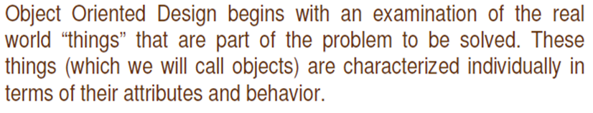
Object Oriented Design
Object oriented design is the result of focusing attention not on the function performed by the program, but instead on the data that are to do manipulated by the program.
It is mainly the process of using an object methodology to design a computing system or application.

Slide 2
Basic Concepts of OOD
Object Oriented Design is not dependent on any specific implementation language. Problems are modeled using objects.
Objects have
Behaviour (they do things)
State (which changes when they do things)

Slide 3
Terminologies related to OOD
Object
The word “Object” is used very frequently and conveys different meaning in different circumstances. Here, meaning is an entity able to save a state (information) and which offers a number of operations (behavior) to either examine or affect this state. An object is characterized by number of operations and a state which remembers the effect of these operations
.

Slide 4
Messages
Objects communicate by message passing. Messages consist of the identity of the target object, the name of the requested operation and any other operation needed to perform the function. Message are often implemented as procedure or function calls.

Slide 5
Abstraction
In object oriented design, complexity is managed using abstraction. Abstraction is the elimination of the irrelevant and the amplification of the essentials.

Slide 6
Class
In any system, there shall be number of objects. Some of the objects may have common characteristics and we can group the objects according to these characteristics. This type of grouping is known as a class. Hence, a class is a set of objects that share a common structure and a common behaviour.

Slide 7
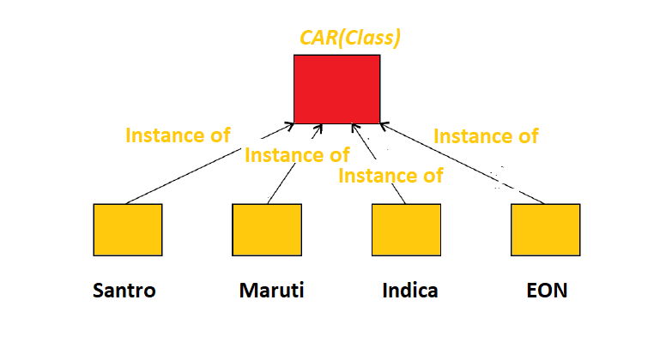
Ex. We may define a class “car” and each object that represent a car becomes an instance of this class. In this class “car”, Indica, Santro, Maruti, Indigo are instances of this class as shown in fig

Slide 8
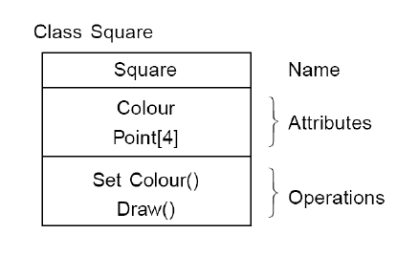
Attributes
An attributes is a data value held by the objects in a class. The square class has two attributes: a colour and array of points. Each attributes has a value for each object instance

Slide 9
Operations
An operation is a function or transformation that may be applied to or by objects in a class.
In the square class, we have two operations: set colour() and draw(). All objects in a class share the same operations. An object “knows” its class, and hence the right implementation of the operation.

Slide 10
Inheritance
OOD allows similar classes to stack up in a hierarchical manner where the lower or sub-classes can import, implement, and re-use allowed variables and functions from their immediate super classes. This property of OOD is called an inheritance. This makes it easier to define a specific class and to create generalized classes from specific ones.

Slide 11
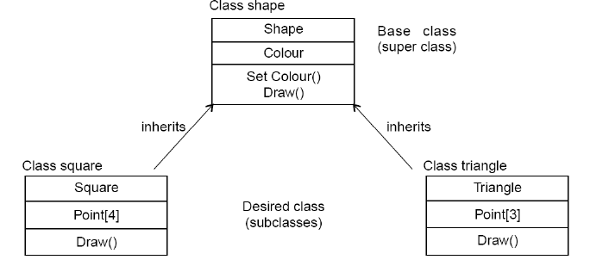
Source: Software Engineering by KK Agarwal &Yogesh Singh

Slide 12
Polymorphism
OOD languages provide a mechanism where methods performing similar tasks but vary in arguments, can be assigned the same name. This is known as polymorphism, which allows a single interface is performing functions for different types.

Slide 13
Encapsulation (Information Hiding)
Encapsulation is also commonly referred to as “Information Hiding”. It consists of the separation of the external aspects of an object from the internal implementation details of the object.

Slide 14
Hierarchy
Hierarchy involves organizing something according to some particular order or rank. It is another mechanism for reducing the complexity of software by being able to treat and express sub-types in a generic way.

Slide 15
Steps for analysis & design of object oriented system
Problem Statement
Create Use Case Model
Draw Activity diagram(if required)
Draw the interaction diagrams
Draw the class diagrams
Draw the state chart, object diagram(if required)
Draw component and deployment diagram
Design document

Slide 16
Create use case model
First step is to identify the actors interacting with the system. We should then write the use case and draw the use case diagram.

Slide 17
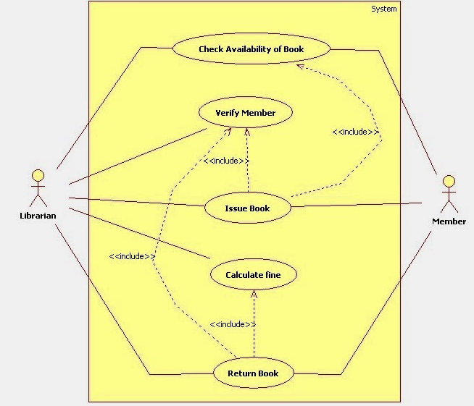
Use Case Diagram of Library Management System

Slide 18
Draw activity diagram (If required)
Activity Diagram illustrate the dynamic nature of a system by modeling the flow of control form activity to activity. An activity represents an operation on some class in the system that results in a change in the state of the system.

Slide 19
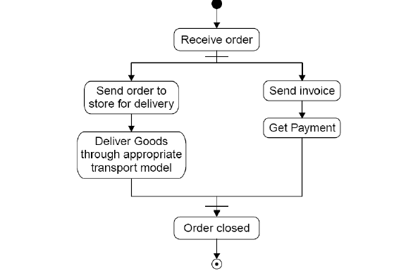
Activity diagram processing an order to deliver some goods.
Source: Software Engineering by KK Agarwal &Yogesh Singh

Slide 20
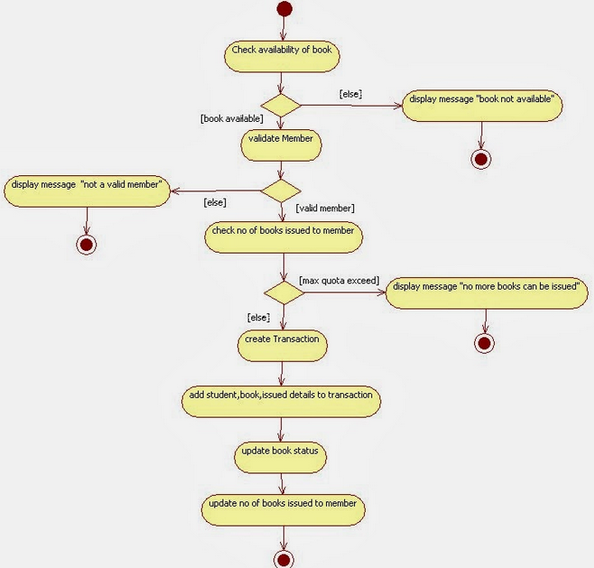
Activity Diagram of Library Management System

Slide 21
Draw the interaction diagram
An interaction diagram shows an interaction, consisting of a set of objects and their relationship, including the messages that may be dispatched among them. Interaction diagrams address the dynamic view of a system
Steps to draws interaction diagrams are as under
a)Firstly, we should identify that the objects with respects to every
use case.
b) We draw the sequence diagrams for every use case.
d) We draw the collaboration diagrams for every use case.

Slide 22
The object types used in this analysis model are entity objects, interface objects and control objects
ENTITY OBJECT INTERFACE OBJECT CONTROL OBJECT

Slide 23
Sequence Diagram
Sequence diagram descries interaction among classes in terms of an exchange of message over time. Sequence diagram demonstrate the behavior of objects in a use case by describing the object and messages they pass. A sequence diagram depicts the sequence of actions that occurs in system. The invocation of methods in each object and the order in which they captured in a sequence diagram. This makes sequence diagram very useful.

Slide 24
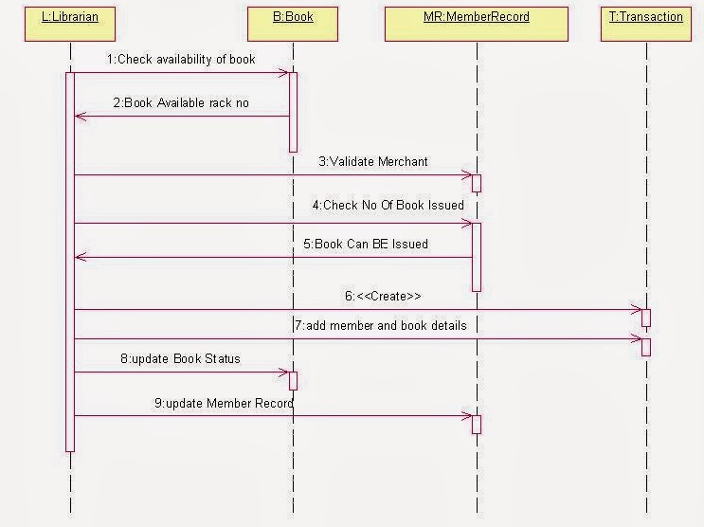
Sequence Diagram of Library Management System

Slide 25
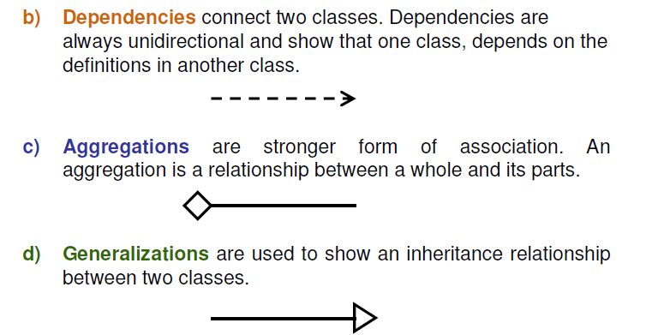
Draw the class diagram
The class diagram shows the relationship amongst classes. There are
four types of relationships in class diagrams.
a) Association are semantic connection between classes. When an association connects two classes, each class can send messages to the other in a sequence or a collaboration
diagram. Associations can be bi-directional or unidirectional.

Slide 26
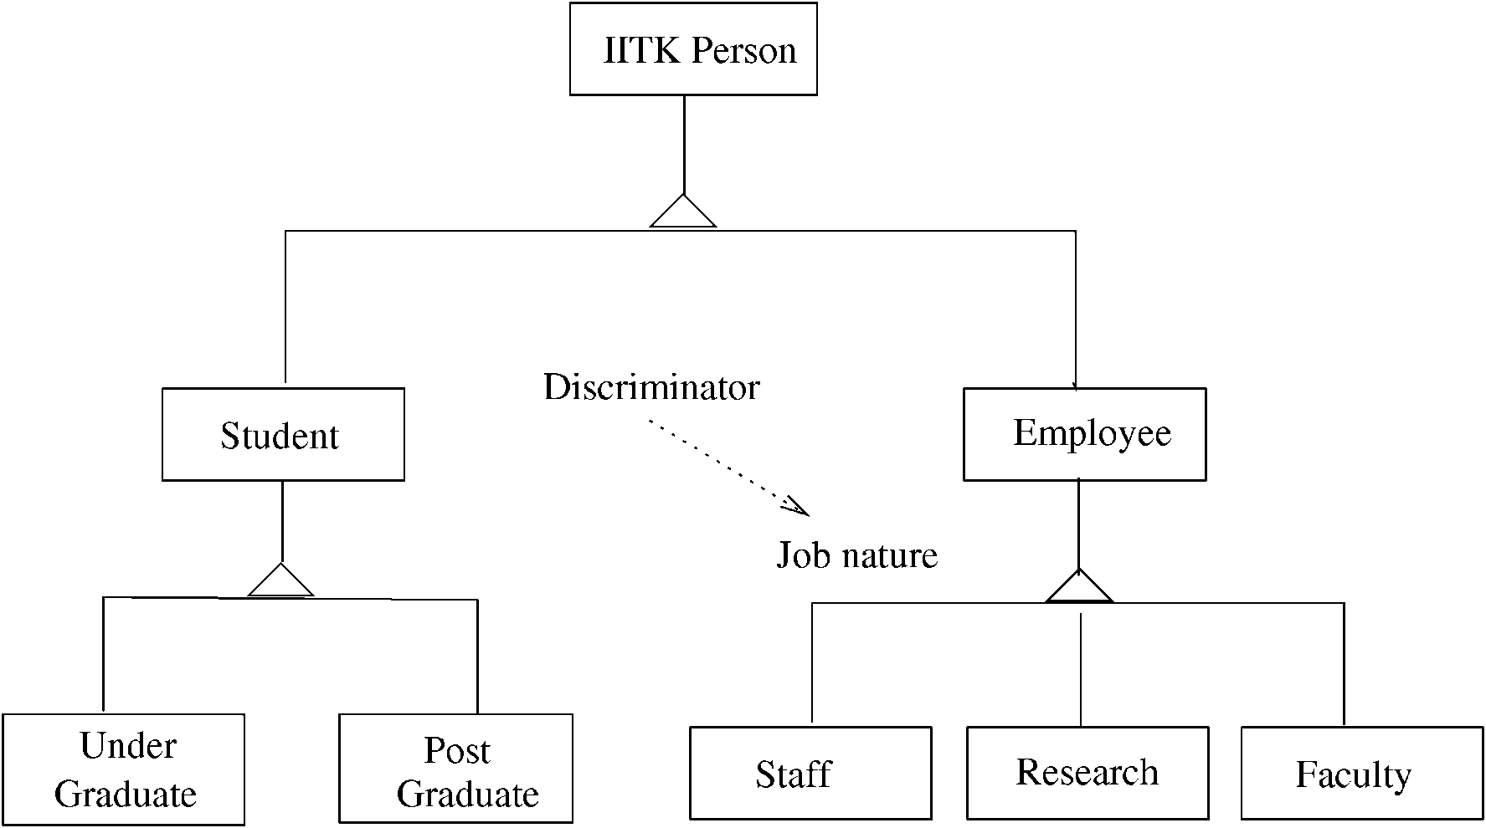
Example – class hierarchy

Slide 27
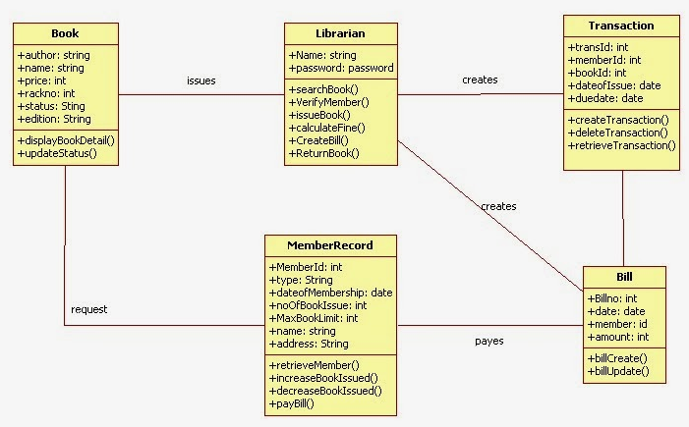
Class Diagram of Library Management System

Slide 28
Design of state chart diagrams
A state chart diagram is used to show the state space of a given class, the event that cause a transition from one state to another, and the action that result from a state change. A state transition diagram for a “book” in the library system is given

Slide 29
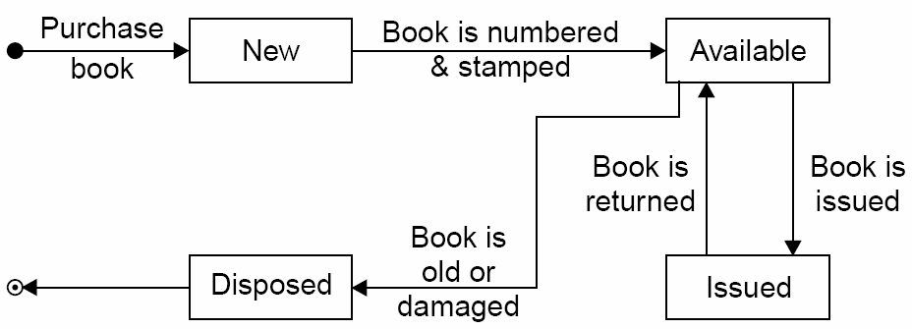
Source: Software Engineering by KK Agarwal &Yogesh Singh

Slide 30
Draw component and development diagram
Component diagrams address the static implementation view of a system they are related to class diagrams in that a component typically maps to one or more classes, interfaces or collaboration.

Slide 31
Unified Modeling Language (UML)
Unified Modeling Language (UML) is a general purpose modeling language. The main aim of UML is to define a standard way to visualize the way a system has been designed. It is quite similar to blueprints used in other fields of engineering.

Slide 32
Unified Modeling Language (UML) and Modeling
UML is a graphical notation useful for OO analysis and design
Allows representing various aspects of the system
Various notations are used to build different models for the system
OOD methodologies use UML to represent the models they create

Slide 33
Modeling
Modeling is used in many disciplines – architecture, aircraft building, …
A model is a simplification of reality
A good model includes those statements that have broad effect and omits minor statements
A model of a system is not the system!

Slide 34
Why build models?
Models help us visualize a system
Help specify the system structure
Gives us a template that can guide the construction
Document the decisions taken and their rationale

Slide 35
Views in an UML
A use case view
A design view
A process view
Implementation view
Deployment view
We will focus primarily on models for design – class diagram, interaction diagram, etc.

Slide 36
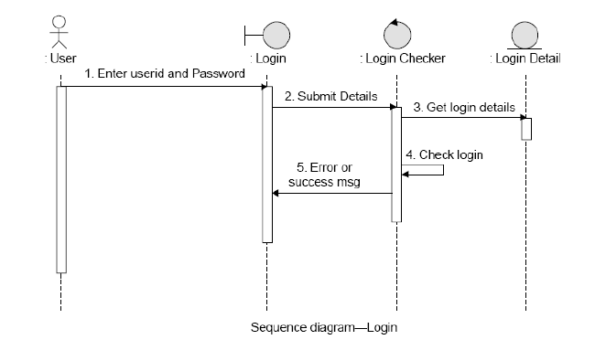
Source: Software Engineering by KK Agarwal &Yogesh Singh

Slide 37
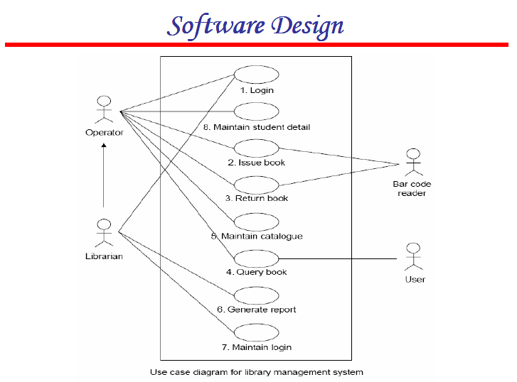

Slide 38
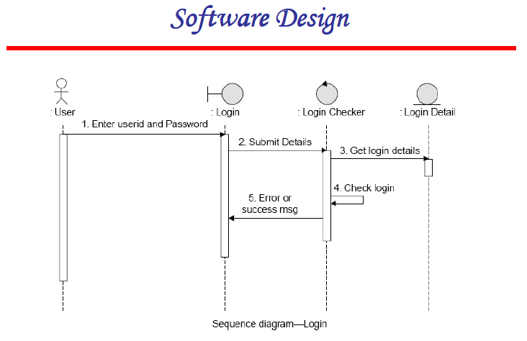

Slide 39
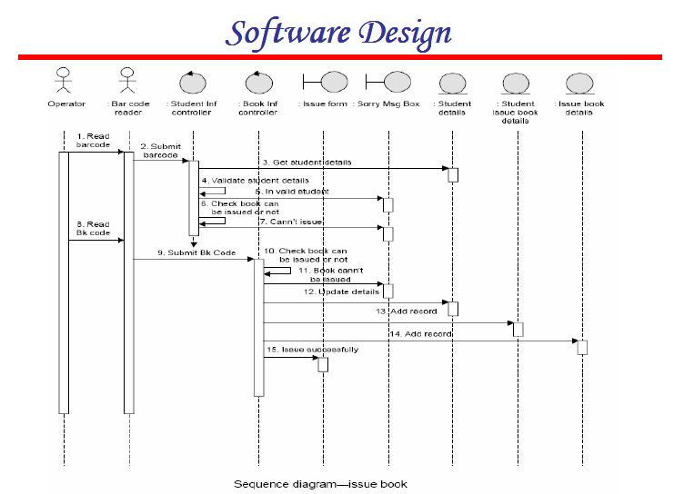

Slide 40
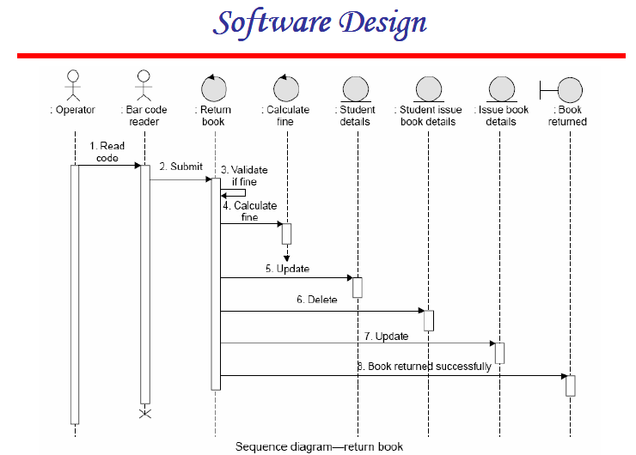

Slide 41
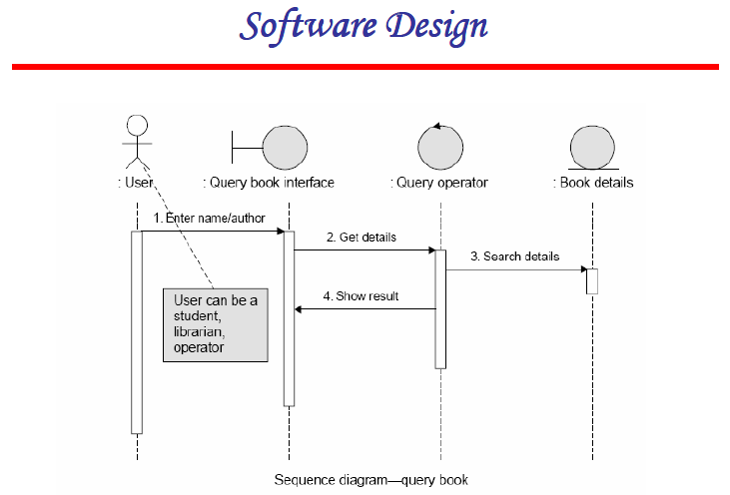

Slide 42
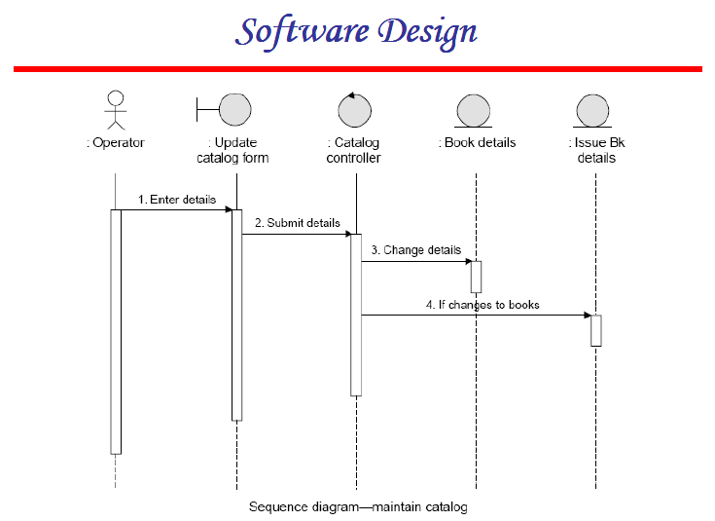

Slide 43
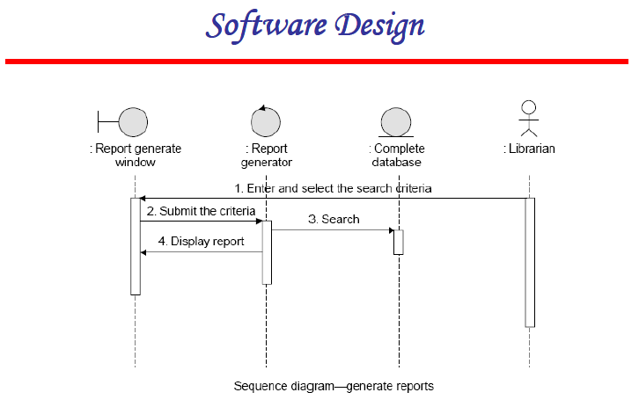

Slide 44
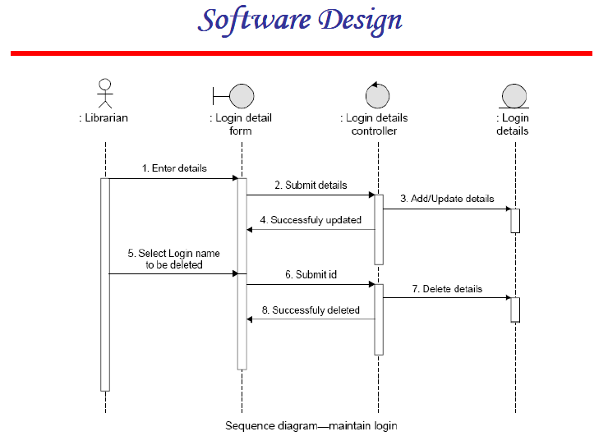

Slide 45
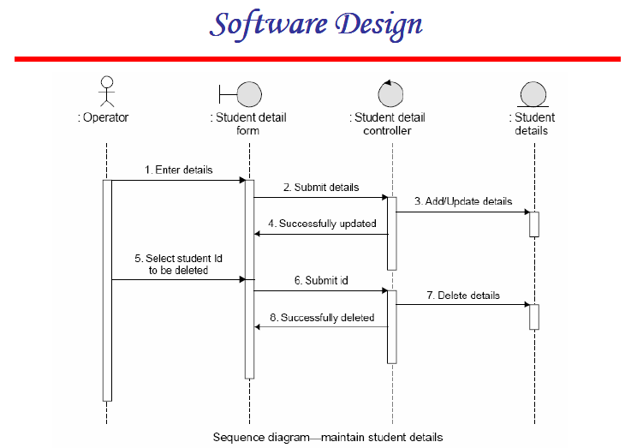

Slide 46
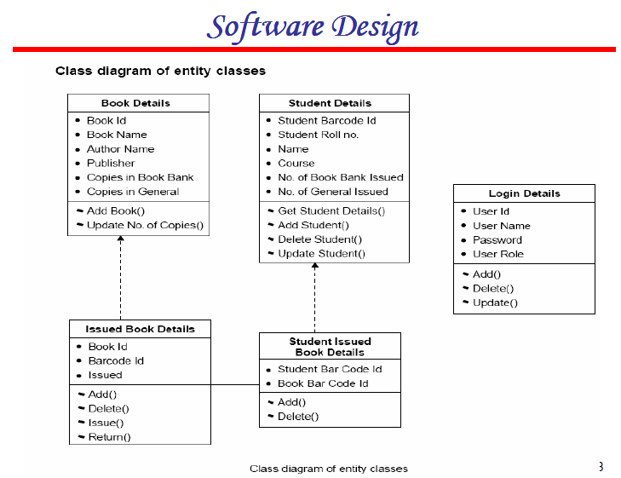

Slide 47
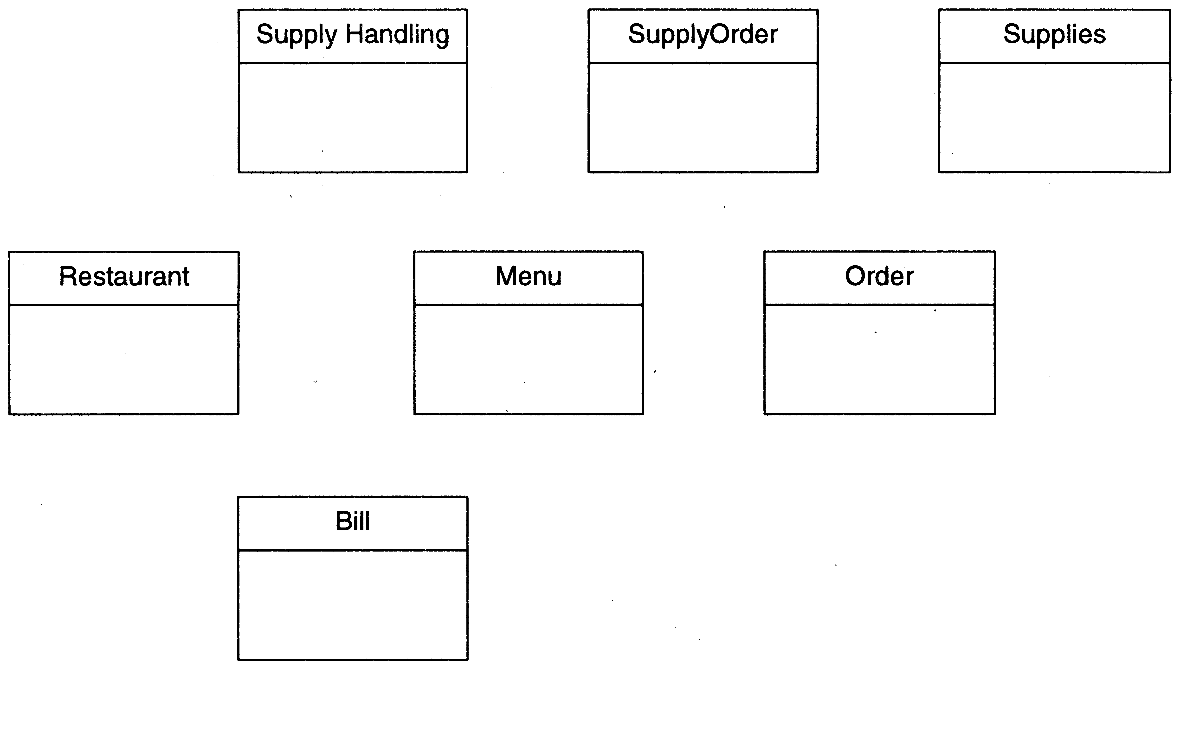
Restaurant example: Initial classes

Slide 48
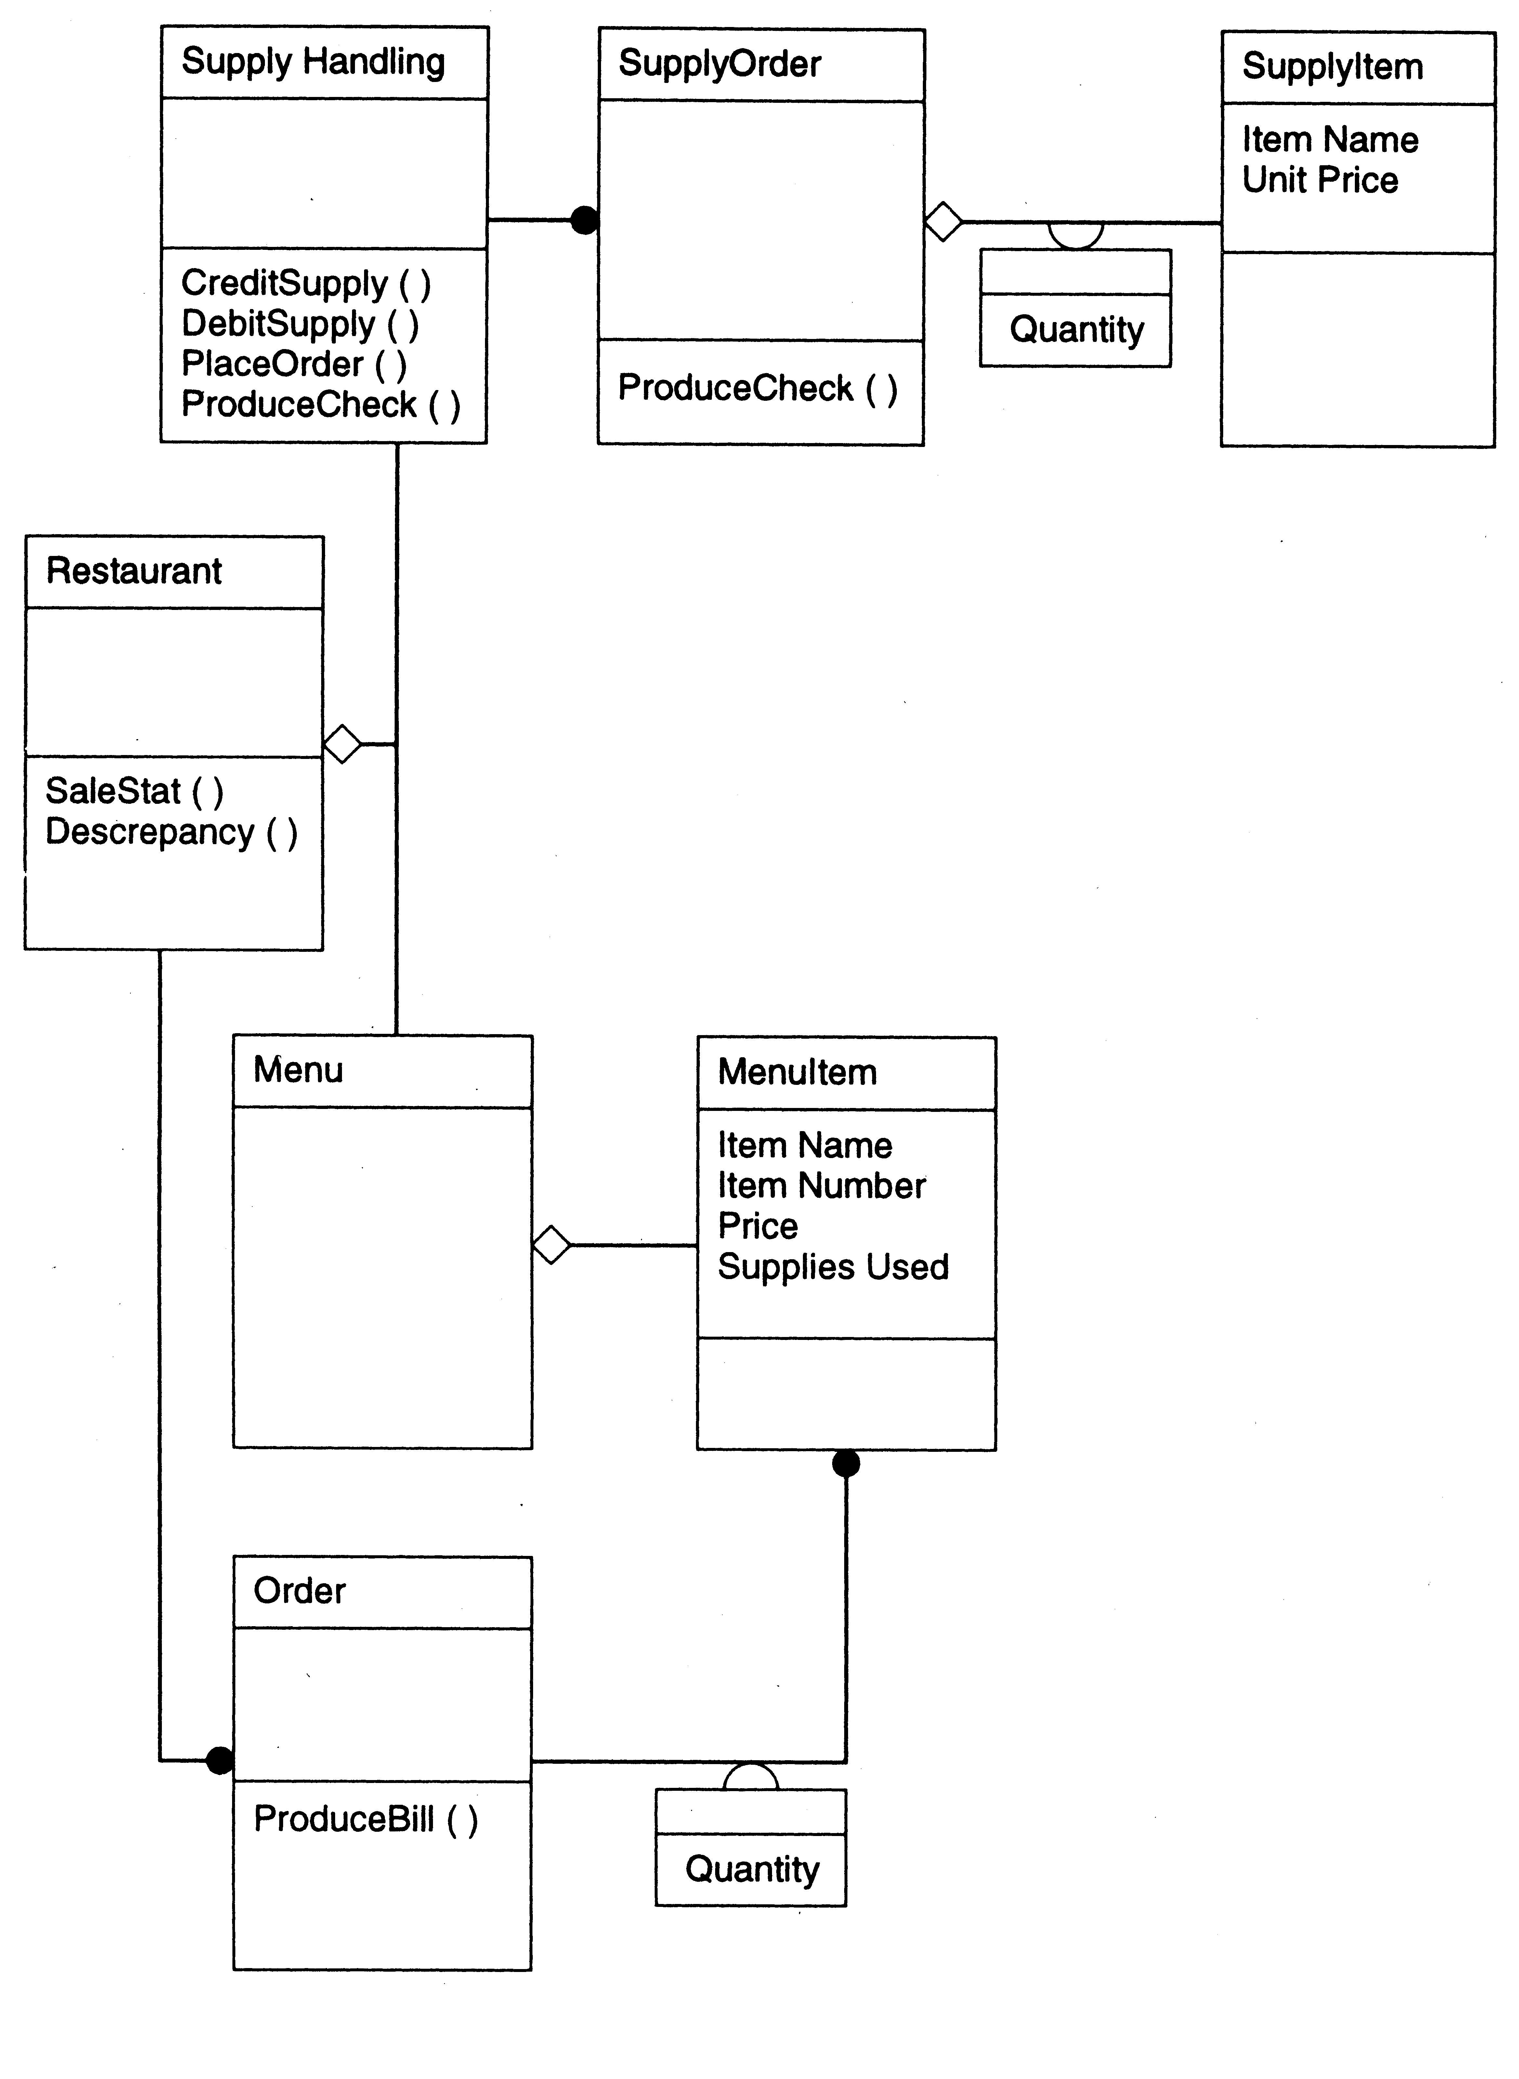

Slide 49
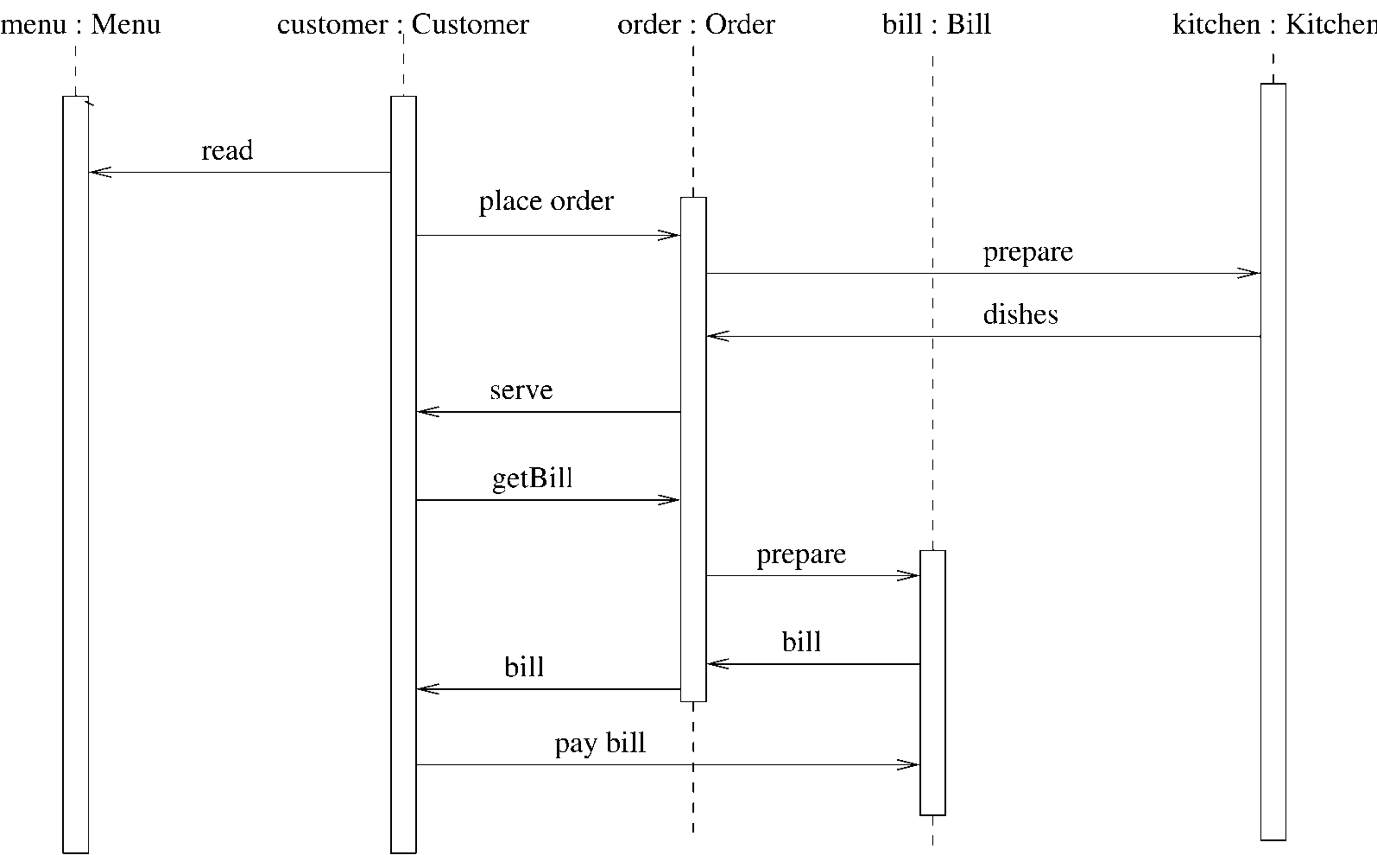
Restaurant example: a seq diag

Slide 50
Coding
The coding is the process of transforming the design of a system into a computer language format. This coding phase of software development is concerned with software translating design specification into the source code. It is necessary to write source code & internal documentation so that conformance of the code to its specification can be easily verified.
Coding is done by the coder or programmers who are independent people than the designer. The goal is not to reduce the effort and cost of the coding phase, but to cut to the cost of a later stage. The cost of testing and maintenance can be significantly reduced with efficient coding.
Source: https://www.javatpoint.com/

Slide 51
Goals of Coding
To translate the design of system into a computer language format: The coding is the process of transforming the design of a system into a computer language format, which can be executed by a computer and that perform tasks as specified by the design of operation during the design phase.
To reduce the cost of later phases: The cost of testing and maintenance can be significantly reduced with efficient coding.
Making the program more readable: Program should be easy to read and understand. It increases code understanding having readability and understandability as a clear objective of the coding activity can itself help in producing more maintainable software.
Source: https://www.javatpoint.com/

Slide 52
Verification
It is the process of evaluating a system or component to determine whether the products of a given development phase satisfy the conditions imposed at the start of that phase.
Validation
It is the process of evaluating a system or component during or at the end of development process to determine whether it satisfies the specified requirements .
Testing= Verification +Validation

Slide 53
Code Inspection
Code Inspection is the most formal type of review, which is a kind of static testing to avoid the defect multiplication at a later stage.
The main purpose of code inspection is to find defects and it can also spot any process improvement if any.
An inspection report lists the findings, which include metrics that can be used to aid improvements to the process as well as correcting defects in the document under review.
Preparation before the meeting is essential, which includes reading of any source documents to ensure consistency.
Inspections are often led by a trained moderator, who is not the author of the code.
The inspection process is the most formal type of review based on rules and checklists and makes use of entry and exit criteria.
It usually involves peer examination of the code and each one has a defined set of roles.
After the meeting, a formal follow-up process is used to ensure that corrective action is completed in a timely manner.
Source: https://www.tutorialspoint.com/

Slide 54
Metrics
A metric is a quantitative measure of the degree to which a system, component or process possesses a given attribute.

Slide 55
Use of Software Metrics
1.How to measure the size of a software?
2. How much will it cost to develop a software?
3. How many bugs can we expect?
4. When can we stop testing?
5. When can we release the software?
6. What is the complexity of a module?
7. What is the module strength and coupling?
8. What is the reliability at the time of release?
9. Which test technique is more effective?
10. Are we testing hard or are we testing smart?
11. Do we have a strong program or a week test suite?

Slide 56
Different Definitions of Metrics
Pressman explained as “A measure provides a quantitative indication of the extent, amount, dimension, capacity, or size of some attribute of the product or process”.
Fenton defined measurement as “ it is the process by which numbers or symbols are assigned to attributes of entities in the real world in such a way as to describe them according to clearly defined rules”.

Slide 57
Software Metrics
Software metrics can be defined as “The continuous application of measurement based techniques to the software development process and its products to supply meaningful and timely management information, together with the use of those techniques to improve that process and its products”.

Slide 58
Categories of Metrics
1:Product metrics: Describe the characteristics of the product such as size, complexity, design features, performance, efficiency, reliability, portability, etc.
2:Process metrics: Describe the effectiveness and quality of the processes that produce the software product.
Examples are:
Effort required in the process
Time to produce the product
Effectiveness of defect removal during development
Number of defects found during testing
Maturity of the process

Slide 59
Continue…
3.Project metrics: Describe the project characteristics and execution.
Examples are :
Number of software developers
Staffing pattern over the life cycle of the software
Cost and schedule
Productivity

Slide 60
Token Count
Halstead Vocabulary
The size of the vocabulary of a program, which consists of the number of unique tokens used to build a program is defined as:
number of unique tokens used to build a program is defined as:
η = η1+ η2
η : vocabulary of a program
η1 : number of unique operators
η2: number of unique operands

Slide 61
Length of the program
Halstead Program Length
The length of the program in the terms of the total number of tokens used is:
N = N1+N2
N : program length
N1 : total occurrences of operators
N2 : total occurrences of operands
Estimated Program Length
N^ = η1 log₂ η1 + η2 log₂ η2

Slide 62
Volume
V = N * log2η
The unit of measurement of volume is the common unit for size “bits”. It is the actual size of a program if a uniform binary encoding for the vocabulary is used.
Potential Volume
V*=(2+η2*) log2 (2+η2*)
unique input and output parameters are represented by η2*
Program Level
L = V* / V
The value of L ranges between zero and one,
with L=1 representing a program written at the highest possible level (i.e., with minimum size).

Slide 63
Program Difficulty
D = 1 / L
As the volume of an implementation of a program increases, the program level decreases and the difficulty increases. Thus, programming practices such as redundant usage of operands, or the failure to use higher-level control constructs will tend to increase the volume as well as the difficulty.
Effort
E = V / L = D * V
The unit of measurement of E is elementary mental discriminations.

Slide 64
Potential Volume=V*=(2+η2*) log2 (2+η2*)
Estimated Program level
L=2 η2 /(η1N2)
Estimated Program Difficulty
D =1/ L

Slide 65
Effort and Time
E(Effort)
E=V / L =V *D
T(Time)
E / β
Normally beta is set to 18

Slide 66
Language Level

Slide 67
Language level by Halstead
Language | Language Level | Variance
PL/1 | 1.53 | 0.92
ALGOL | 1.21 | 0.74
FORTRAN | 1.14 | 0.81
CDC Assembly | 0.88 | 0.42
PASCAL | 2.54 | ----
APL | 2.42 | ----
C | 0.857 | 0.445

Slide 68
Counting rules for C language
1.Comments are not considered.
2. The identifier and function declarations are not considered.
3. All the variables and constants are considered operands.
4. Global variables used in different modules of the same program are counted as multiple occurrences of the same variable.

Slide 69
5.Local variables with the same name in different functions are counted as unique operands.
6. Functions calls are considered as operators.
7. All looping statements e.g., do {…} while ( ), while ( ) {…}, for ( ) {…}, all control statements e.g., if ( ) {…}, if ( ) {…} else {…}, etc. are considered as operators.
8. In control construct switch ( ) {case:…}, switch as well as all the case statements are considered as operators.

Slide 70
The reserve words like return, default, continue, break, sizeof, etc., are considered as operators.
10. All the brackets, commas, and terminators are considered as operators.
11.GOTO is counted as an operator and the label is counted as an operand.
12. The unary and binary occurrence of “+” and “-” are dealt separately. Similarly “*” (multiplication operator) are dealt with separately.

Slide 71
13.In the array variables such as “array-name [index]” “arrayname” and “index” are considered as operands and [ ] is considered as operator.
14. In the structure variables such as “struct-name, member-name” or “struct-name -> member-name”, struct-name, member-name are taken as operands and ‘.’, ‘->’ are taken as operators. Some names of member elements in different structure variables are counted as unique operands.
15. All the hash directive are ignored.

Slide 72
Problem-1
Consider the sorting program as mentioned below. List out the operators and operands and also calculate the values of software science measures like

Slide 73
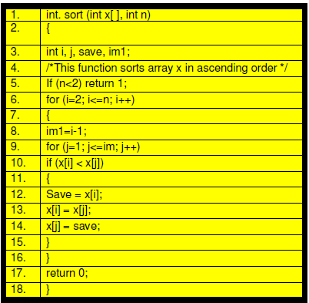
Program

Slide 74
List of Operands & Operators
Operators | Occurrence | Operands | Occurrence
Int | 4 | SORT | 1
() | 5 | x | 7
, | 4 | n | 3
[] | 7 | i | 8
If | 2 | j | 7
< | 2 | save | 3
; | 11 | im1 | 3
for | 2 | 2 | 2
= | 6 | 1 | 3
- | 1 | 0 | 1
<= | 2 | - | -
++ | 2 | - | -
return | 2 | - | -
{} | 3 | - | -

Slide 75
Program Length: N=N1+N2=53+38=91
Vocabulary of the program: η1+ η2=14+10=24
Volume: V=N X log₂ η2=91x log₂ 24=417 bits
The estimated program length N
η1 log₂ η1 + η2 log₂ η2
14 log₂ 14 +10log₂ 10=86.45
Potential Volume=V*=(2+η2*) log2 (2+η2*)
unique input and output parameters are represented by η2*
η2*=3 so V*=(2+3) log2 (2+3)=11.6

Slide 76
Program Level
L = V* / V=11.6/417=0.027
Program Difficulty
D = 1 / L =1/0.027=37.03
Estimated program level L

